Slide 1



BOOTSTRAP

Slide 2
SYNOPSIS
Bootstrap Overview – Introduction
File Structure
Grid System
CSS Overview
Typography
Tables
Forms
Buttons
Images
Helper Class

Slide 3
What is Twitter Bootstrap?
Bootstrap is a powerful mobile first front-end framework for faster and easier web development. It uses HTML, CSS and JavaScript.

Slide 4
History
Bootstrap was developed by Mark Otto and Jacob Thornton at Twitter. It was released as an open source product in August 2011 on GitHub.

Slide 5

Why use Bootstrap?
Mobile first approach:
Since Bootstrap 3, the framework consists of Mobile first styles throughout the entire library instead of in separate files.
Browser Support:
It is supported by all popular browsers.

Slide 6

Why use Bootstrap?
Easy to get started:
With just the knowledge of HTML and CSS anyone can get started with Bootstrap. Also the Bootstrap official site has a good documentation.
Responsive design:
  Responsive web design is an approach to web design which makes web pages render well on a variety of devices and window or screen sizes.
  Bootstrap's responsive CSS adjusts to Desktops, Tablets and Mobiles.

Slide 7
What Bootstrap Package Includes?
Scaffolding: Bootstrap provides a basic structure with Grid System, link styles, background. This is covered in detail in the section Bootstrap Basic Structure
CSS: Bootstrap comes with feature of global CSS settings, fundamental HTML elements styled and ehanced with extensible classes, and an advanced grid system. This is covered in detail in the section Bootstrap with CSS.
Components: Bootstrap contains over a dozen reusable components built to provide iconography, dropdowns, navigation, alerts, popovers, and much more..

Slide 8
What Bootstrap Package Includes?
JavaScript Plugins: Bootstrap contains over a dozen custom jQuery plugins. You can easily include them all, or one by one. This is covered in details in the section Bootstrap Plugins.
Customize: You can customize Bootstrap's components, LESS variables, and jQuery plugins to get your very own version.
You can download the latest version of Bootstrap from http://getbootstrap.com/.
Download Bootstrap

Slide 9
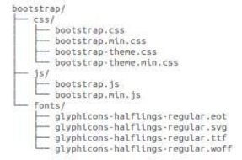
File structure
PRECOMPILED BOOTSTRAP
Once the compiled version Bootstrap is downloaded, extract the ZIP file, and you will see the following file/directory structure:
As you can see there are compiled CSS and JS (bootstrap.*), as well as compiled and minified CSS and JS (bootstrap.min.*). Fonts from Glyphicons are included, as is the optional Bootstrap theme.

Slide 10
Getting Started
  Download
  <head>
  <meta name="viewport" content="width=device-width, initial-scale=1">
  <link rel="stylesheet" href="Bootstrap/css/bootstrap.min.css">
  …………
  …………
  </head>
  Bootstrap CDN (Content Delivery Network)
  <link rel="stylesheet" href="https://maxcdn.bootstrapcdn.com/bootstrap/3.3.7/css/bootstrap.min.css">
  !-- Latest compiled JavaScript -->
  <script src="https://maxcdn.bootstrapcdn.com/bootstrap/3.3.7/js/bootstrap.min.js"></script>

Slide 11
What is Bootstrap Grid System?
As put by the official documentation of Bootstrap for grid system:
Bootstrap includes a responsive, mobile first fluid grid system that appropriately scales up to 12 columns as the device or view port size increases. It includes predefined classes for easy layout options, as well as powerful mixins for generating more semantic layouts.
Let us understand the above statement. Bootstrap 3 is mobile first in the sense that the code for Bootstrap now starts by targeting smaller screens like mobile devices, tablets, and then “expands” components and grids for larger screens such as laptops, desktops.

Slide 12
Working of Bootstrap Grid System
Grid systems are used for creating page layouts through a series of rows and columns that house your content.
Here's how the Bootstrap grid system works:
Rows must be placed within a .container class for proper alignment and padding.
Use rows to create horizontal groups of columns.
Content should be placed within columns, and only columns may be immediate children of rows.
Predefined grid classes like .row and .col-xs-4 are available for quickly making grid layouts. LESS mixins can also be used for more semantic layouts.
Columns create gaps between column content via padding. That padding is offset in rows for the first and last column via negative margin on .rows.
Grid columns are created by specifying the number of twelve available columns you wish to span. For example, three equal columns would use three .col-xs-4.

Slide 13
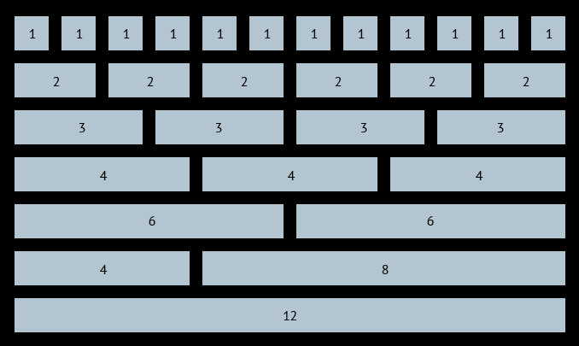
Bootstrap Grid System

Slide 14
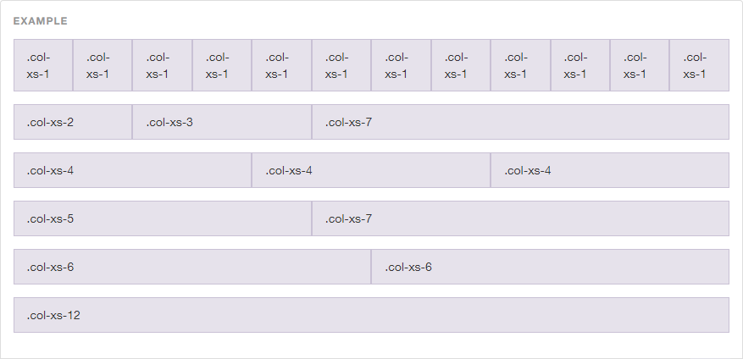
Bootstrap Grid System

Slide 15
Bootstrap Grid System
The Bootstrap grid system has four classes:
xs (for phones - screens less than 768px wide)
sm (for tablets - screens equal to or greater than 768px wide)
md (for small laptops - screens equal to or greater than 992px wide)
lg (for laptops and desktops - screens equal to or greater than 1200px wide)
Total number of columns must add up to 12

Slide 16
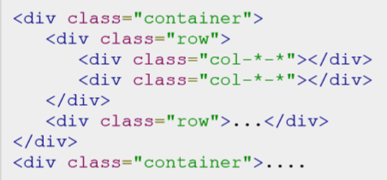
BASIC GRID STRUCTURE
<div class="row">
<div class="col-sm-4 ">
<h3>Column 1</h3>
<p>Some Text Here…..</p>
<p>Some Text Here…..</p>
</div>
<div class="col-sm-4">
<h3>Column 2</h3>
<p>Some Text Here…..</p>
<p>Some Text Here…..</p>
</div>
<div class="col-sm-4">
<h3>Column 3</h3>
<p>Some Text Here…..</p>
<p>Some Text Here…..</p>
</div>
</div>
Following is basic structure of Bootstrap grid:

Slide 17
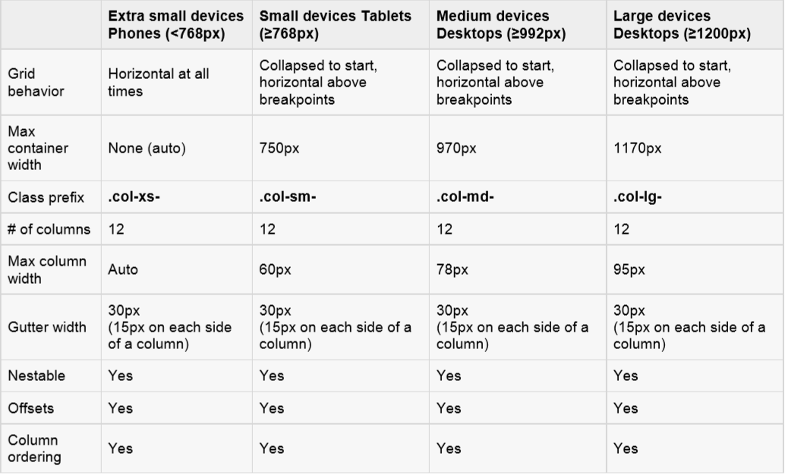
Grid options:
The following table summarizes aspects of how Bootstrap grid system works across multiple devices:

Slide 18
Bootstrap Grid System Example: Mobile, Tablet, Desktops
Now this gives us 3 different column layouts <div class="container">
On a phone, it will be 25% on the left, and 75% on the right.
On a tablet, it will be 50%/50% again,
Large viewport, it will be 33%/66%.
3 different layouts for each of the 3 responsive sizes. Check it out in the following example.

Slide 19
CSS Overview
HTML5 doctype:
Bootstrap makes use of certain HTML elements and CSS properties that require the use of the HTML5 doctype. Hence include the below piece of code for HTML5 doctype at the beginning of all your projects using Bootstrap.
<!DOCTYPE html>
<html>
....
</html>

Slide 20

Responsive images
Bootstrap 3 allows to make the images responsive by adding a class .img-responsive to the <img>tag. This class applies max-width: 100%; and height: auto; to the image so that it scales nicely to the parent element.
<img src="..." class="img-responsive" alt="Responsive image">

Slide 21
Containers:
Use class .container to wrap a page's content and easily centre the content's as shown below.
<div class="container"> ... </div>
Take a look at the .container class in bootstrap.css file:
.container {
padding-right: 15px;
padding-left: 15px;
margin-right: auto;
margin-left: auto;
}
Note that, due to padding and fixed widths, containers are not nestable by default.
Take a look at bootstrap.css file:
@media (min-width: 768px) {
.container {
width: 750px;
}

Slide 22
Media Queries
Media Types
all: Used for all media type devices
print : Used for printers
screen: Used for computer screens, tablets, smart-phones etc.
speech: Used for screenreaders that "reads" the page out loud
Media query is a CSS technique introduced in CSS3.
It uses the @media rule to include a block of CSS properties only if
a certain condition is true.
Media queries can be used to check many things, such as:
  width and height of the viewport
  width and height of the device
  orientation (is the tablet/phone in landscape or portrait mode?)
  resolution
  @media not|only mediatype and (expressions) {
  CSS-Code; }
  Unless you use the not or only operators, the media type is optional and the all type will be implied.
  @media screen and (min-width: 480px) and (max-width:600px) {
  #leftsidebar {width: 200px; float: left;}
  #main {margin-left: 216px;}
  }
CSS Rules
@import
@media
@fontface
@charset
CSS rule

Slide 23
Media Features
max-width
min-width
max-resolution
Orientation (e.g. landscape)
Example
@media screen and (min-width: 400px) {
body {
background-color: aqua;
}
}
@media screen and (min-width: 800px) {
body {
background-color: green;
}
}

Slide 24
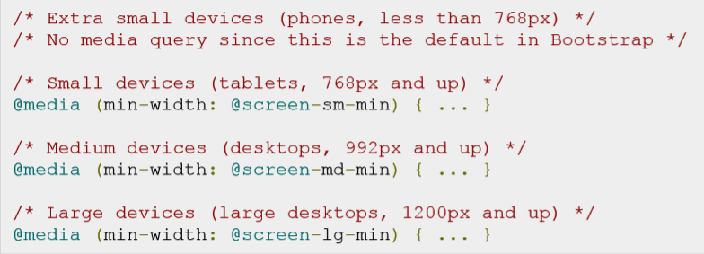
Media Queries :
Media query is a really fancy term for "conditional CSS rule". It simply applies some CSS based on certain conditions set forth. If those conditions are met, the style is applied.
Media Queries in Bootstrap allow you to move, show and hide content based on viewport size. Following media queries are used in LESS files to create the key breakpoints in the Bootstrap grid system.

Slide 25
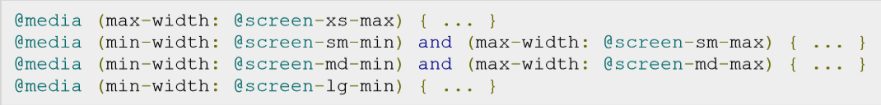
Media Queries :
Occasionally these are expanded to include a max-width to limit CSS to a narrower set of devices.

Slide 26
Typography
Bootstrap uses Helvetica Neue, Helvetica, Arial, and sans-serif in its default font stack. Using typography feature of Bootstrap you can create headings, paragraphs, lists and other inline elements.
Headings:
All HTML headings (h1 to h6) are styled in Bootstrap. An example is as shown below:
<h1>I'm Heading1 h1</h1>
<h2>I'm Heading2 h2</h2>
<h3>I'm Heading3 h3</h3>
<h4>I'm Heading4 h4</h4>
<h5>I'm Heading5 h5</h5>
<h6>I'm Heading6 h6</h6>

Slide 27
Typography
INLINE SUBHEADINGS:
To add an inline subheading to any of the headings, simply add <small> around any of the elements or add .small class and you will get smaller text in a lighter color as shown in the example below:
<h1>I'm Heading1 h1. <small>I'm secondary Heading1 h1</small></h1>
<h2>I'm Heading2 h2. <small>I'm secondary Heading2 h2</small></h2>
<h3>I'm Heading3 h3. <small>I'm secondary Heading3 h3</small></h3>
<h4>I'm Heading4 h4. <small>I'm secondary Heading4 h4</small></h4>
<h5>I'm Heading5 h5. <small>I'm secondary Heading5 h5</small></h5>
<h6>I'm Heading6 h6. <small>I'm secondary Heading1 h6</small></h6>

Slide 28
Typography
LISTS:
Bootstrap supports ordered lists, unordered lists, and definition lists.
Ordered lists: An ordered list is a list that falls in some sort of sequential order and is prefaced by numbers.
Unordered lists: An unordered list is a list that doesn’t have any particular order and is traditionally styled with bullets. If you do not want the bullets to appear then you can remove the styling by using the class .listunstyled. You can also place all list items on a single line using the class .list-inline.

Slide 29
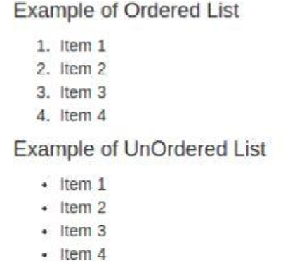
Typography
Code with Example for Lists:
<h4>Example of Ordered List</h4>
<ol>
<li>Item 1</li>
<li>Item 2</li> <li>Item 3</li>
<li>Item 4</li>
</ol>
<h4>Example of UnOrdered List</h4>
<ul>
<li>Item 1</li>
<li>Item 2</li>
<li>Item 3</li >
<li>Item 4</li>
</ul>
OUTPUT:

Slide 30
Tables
Basic Table:
If you want a nice, basic table style with just some light padding and horizontal dividers, add the base class of .table to any table as shown in the following example:
<table class="table">
<caption>Basic Table Layout</caption>
.
.
.
</table>

Slide 31
Tables
STRIPED TABLE :
By adding the .table-striped class, you will get stripes on rows within the <tbody> as seen in the following example:
<table class="table table-striped">
<caption>Striped Table Layout</caption>
.
.
.
</table>

Slide 32
Tables
BORDERED TABLE :
By adding the .table-bordered class, you will get borders surrounding every element and rounded corners around the entire table as seen in the following example:
<table class="table table-bordered">
<caption>Striped Table Layout</caption>
.
.
.
</table>

Slide 33
Tables
HOVER TABLE :
By adding the .table-hover class, a light gray background will be added to rows while the cursor hovers over them, as seen in the following example:
<table class="table table-hover">
<caption>Striped Table Layout</caption>
.
.
.
</table>

Slide 34
Tables
RESPONSIVE TABLES:
By wrapping any .table in .table-responsive class, you will make the table scroll horizontally up to small devices (under 768px). When viewing on anything larger than 768px wide, you will not see any difference in these tables.
<div class="table-responsive">
<table class="table">
<caption>Responsive Table Layout</caption>
.
.
.
</table>
</div>

Slide 35
Forms
Here we will discuss, how to create forms with ease using Bootstrap.
Form Layout:
Bootstrap provides you with following types of form layouts:
  Vertical (default) form
  Inline form
  Horizontal form

Slide 36
Forms
VERTICAL OR BASIC FORM:
  Add a role form to the parent <form> element.
  Wrap labels and controls in a <div> with class .form-group. This is needed for optimum spacing.
  Add a class of .form-control to all textual <input>, <textarea>, and <select> elements.
  <form role="form">
  <div class="form-group">
  <label for="name">Name</label>
  <input type="text" class="form-control" id="name" placeholder="Enter Name">
  </div>
  </form>

Slide 37
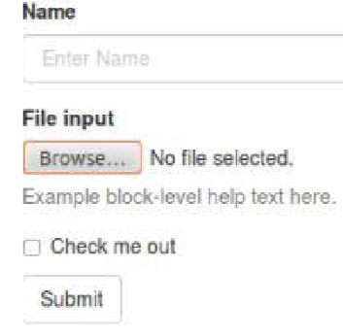
Forms
VERTICAL OR BASIC FORM:
  Add a role form to the parent <form> element.
  Wrap labels and controls in a <div> with class .form-group. This is needed for optimum spacing.
  Add a class of .form-control to all textual <input>, <textarea>, and <select> elements.
<form role="form">
  <div class="form-group">
  <label for="name">Name</label>
  <input type="text" class="form-control" id="name" placeholder="Enter Name">
  </div>
</form>

Slide 38
Forms
INLINE FORM :
To create a form where all of the elements are inline, left aligned and labels are alongside, add the class .forminline to the <form> tag.
<form class="form-inline" role="form">
<div class="form-group">
<label class="sr-only" for="name">Name</label>
<input type="text" class="form-control" id="name" placeholder="Enter Name">
</div>
</form>

Slide 39
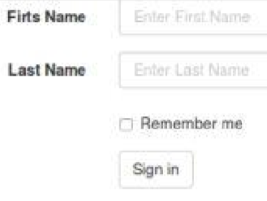
Forms
HORIZONTAL FORM:
  Add a class of .form-horizontal to the parent <form> element.
  Wrap labels and controls in a <div> with class .form-group.
  Add a class of .control-label to the labels.
<form class="form-horizontal" role="form">
<div class="form-group">
<label for="firstname" class="col-sm-2 control-label">First Name</label>
<div class="col-sm-10">
<input type="text" class="form-control"
id="firstname“ placeholder="Enter First Name">
</div>
</div>
</forms>

Slide 40
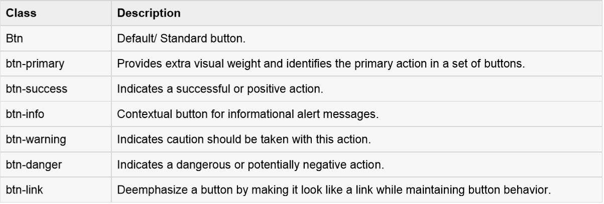
Buttons
Here we will discuss about how to use Bootstrap button with examples. Anything that is given a class of .btn will inherit the default look of a gray button with rounded corners.

Slide 41
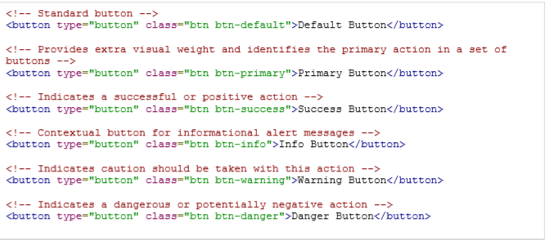
Buttons
Following example demonstrates all the above button classes:
OUTPUT:

Slide 42
Images
Bootstrap provides three classes that can be used to apply some simple styles to images:
.img-rounded: adds border-radius:6px to give the image rounded corners.
.img-circle: makes the entire image round by adding border-radius:500px.
.img-thumbnail: adds a bit of padding and a gray border:

Slide 43
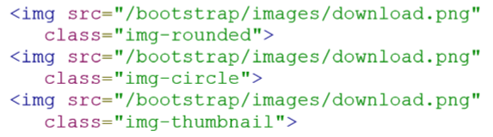
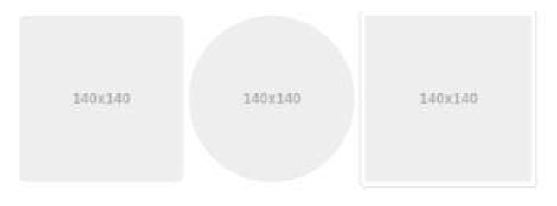
Images
The following example demonstrates this:
OUTPUT:

Slide 44
CSS Preprocessors
Pre-processors extend CSS with variables, operators, interpolations, functions, mixins etc.
Different CSS pre-processors are available
  such as Less, Sass and Stylus.
Pre-processors, with their advanced features, helped to achieve writing reusable, maintainable and extensible codes in CSS. By using a pre-processor, you can easily increase your productivity, and decrease the amount of code you are writing in a project.

Slide 45
They give us a number of benefits over plain CSS
  Variables, so that you can define and easily change values throughout your stylesheet. Dynamically calculated values. (In CSS we recently got calc, but it is only for length units.)
  Mixins: these enables us to use an existing class or ids and apply all it's styles directly to another selector.
  Functions, which give you a number of handy utilities for manipulating color, converting images to data-uris and more.
  What is Data URI?

Slide 46
LESS : Example (Variables)
Less is written in javascript
Code written with LESS is converted to regular CSS after compilation
LESS
@background-color: #ffffff;
@text-color: #1A237E;
p{ background-color: @background-color; color: @text-color; padding: 15px; }
ul{ background-color: @background-color; }
li{ color: @text-color; }
CSS
p{ background-color: #ffffff;
color: #1A237E; padding: 15px; }
ul{ background-color: #ffffff; }
li{ color: #1A237E; }

Slide 47
LESS : Example (Mixins)
LESS enables us to use an existing class or ids and apply all it's styles directly to another selector.
LESS
#circle{ background-color: #4CAF50;
border-radius: 100%; }
#small-circle{ width: 50px;
height: 50px;
#circle }
#big-circle{ width: 100px;
height: 100px;
#circle }
CSS
#circle { background-color: #4CAF50;
border-radius: 100%; }
#small-circle { width: 50px;
height: 50px;
background-color: #4CAF50;
border-radius: 100%; }
#big-circle { width: 100px; height: 100px; background-color: #4CAF50;
border-radius: 100%; }

Slide 48
@cdnPrefix: "https://s3.amazonaws.com/some-bucket";
// now you can use this var anywhere...
.my-class {
background-image: url("@{cdnPrefix}/images/bg-image.png");
}

